Slide 1
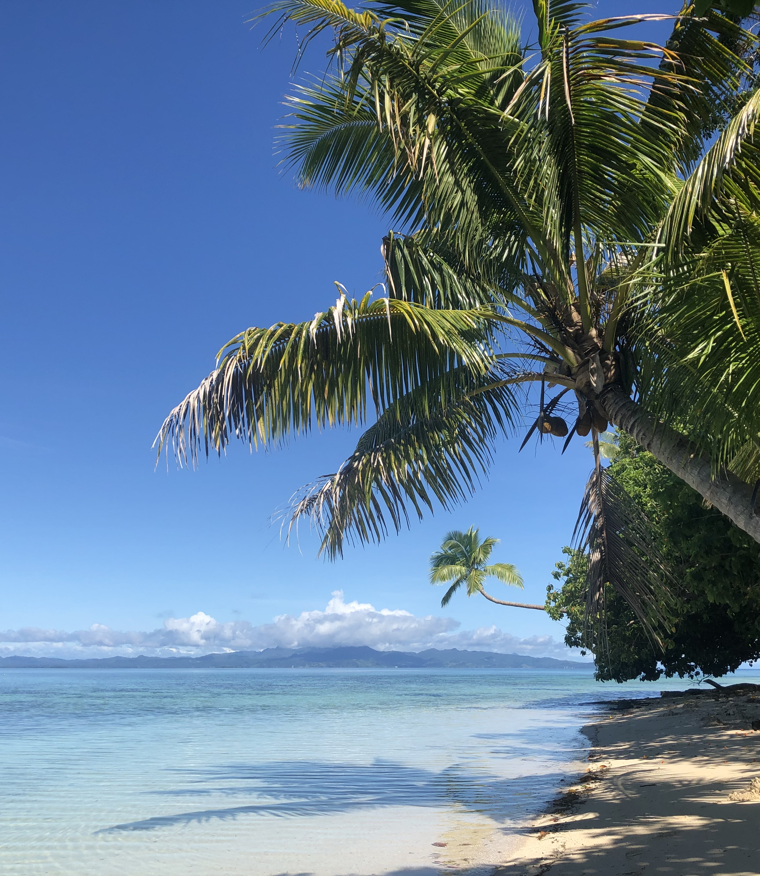
OCN 479-001
Dr. Phil Bresnahan

Slide 2
Intro to the class
Course goals
Paper syllabus
Canvas (👈 our map from now on)
Introduce myself/my background

Slide 3
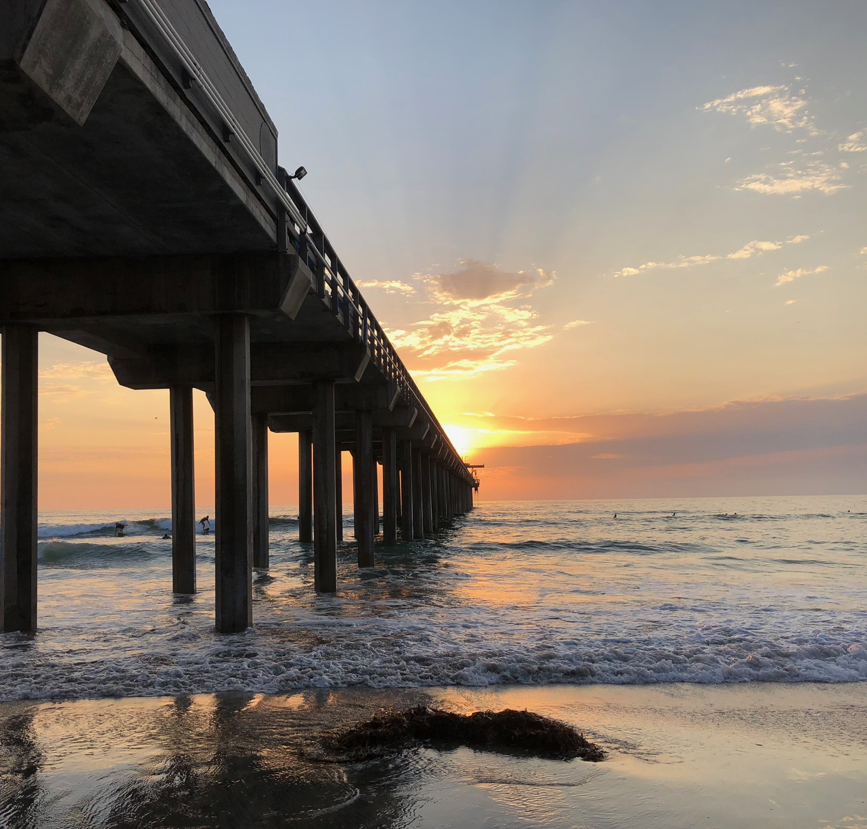
Course Goals

Slide 4
Goals
Stay healthy and help others stay healthy! Covid-19 is still here. Wear a mask if you want (I will as well).
Open (some of) the black boxes of coastal technologies
Build new, cool devices (more on this soon)

Slide 5
General Schedule
Deadlines will all be on Canvas
Homeworks, interactive assignments, and exams all have strict due dates!
Presentation and project dates are on paper syllabus and are being added to Canvas

Slide 6
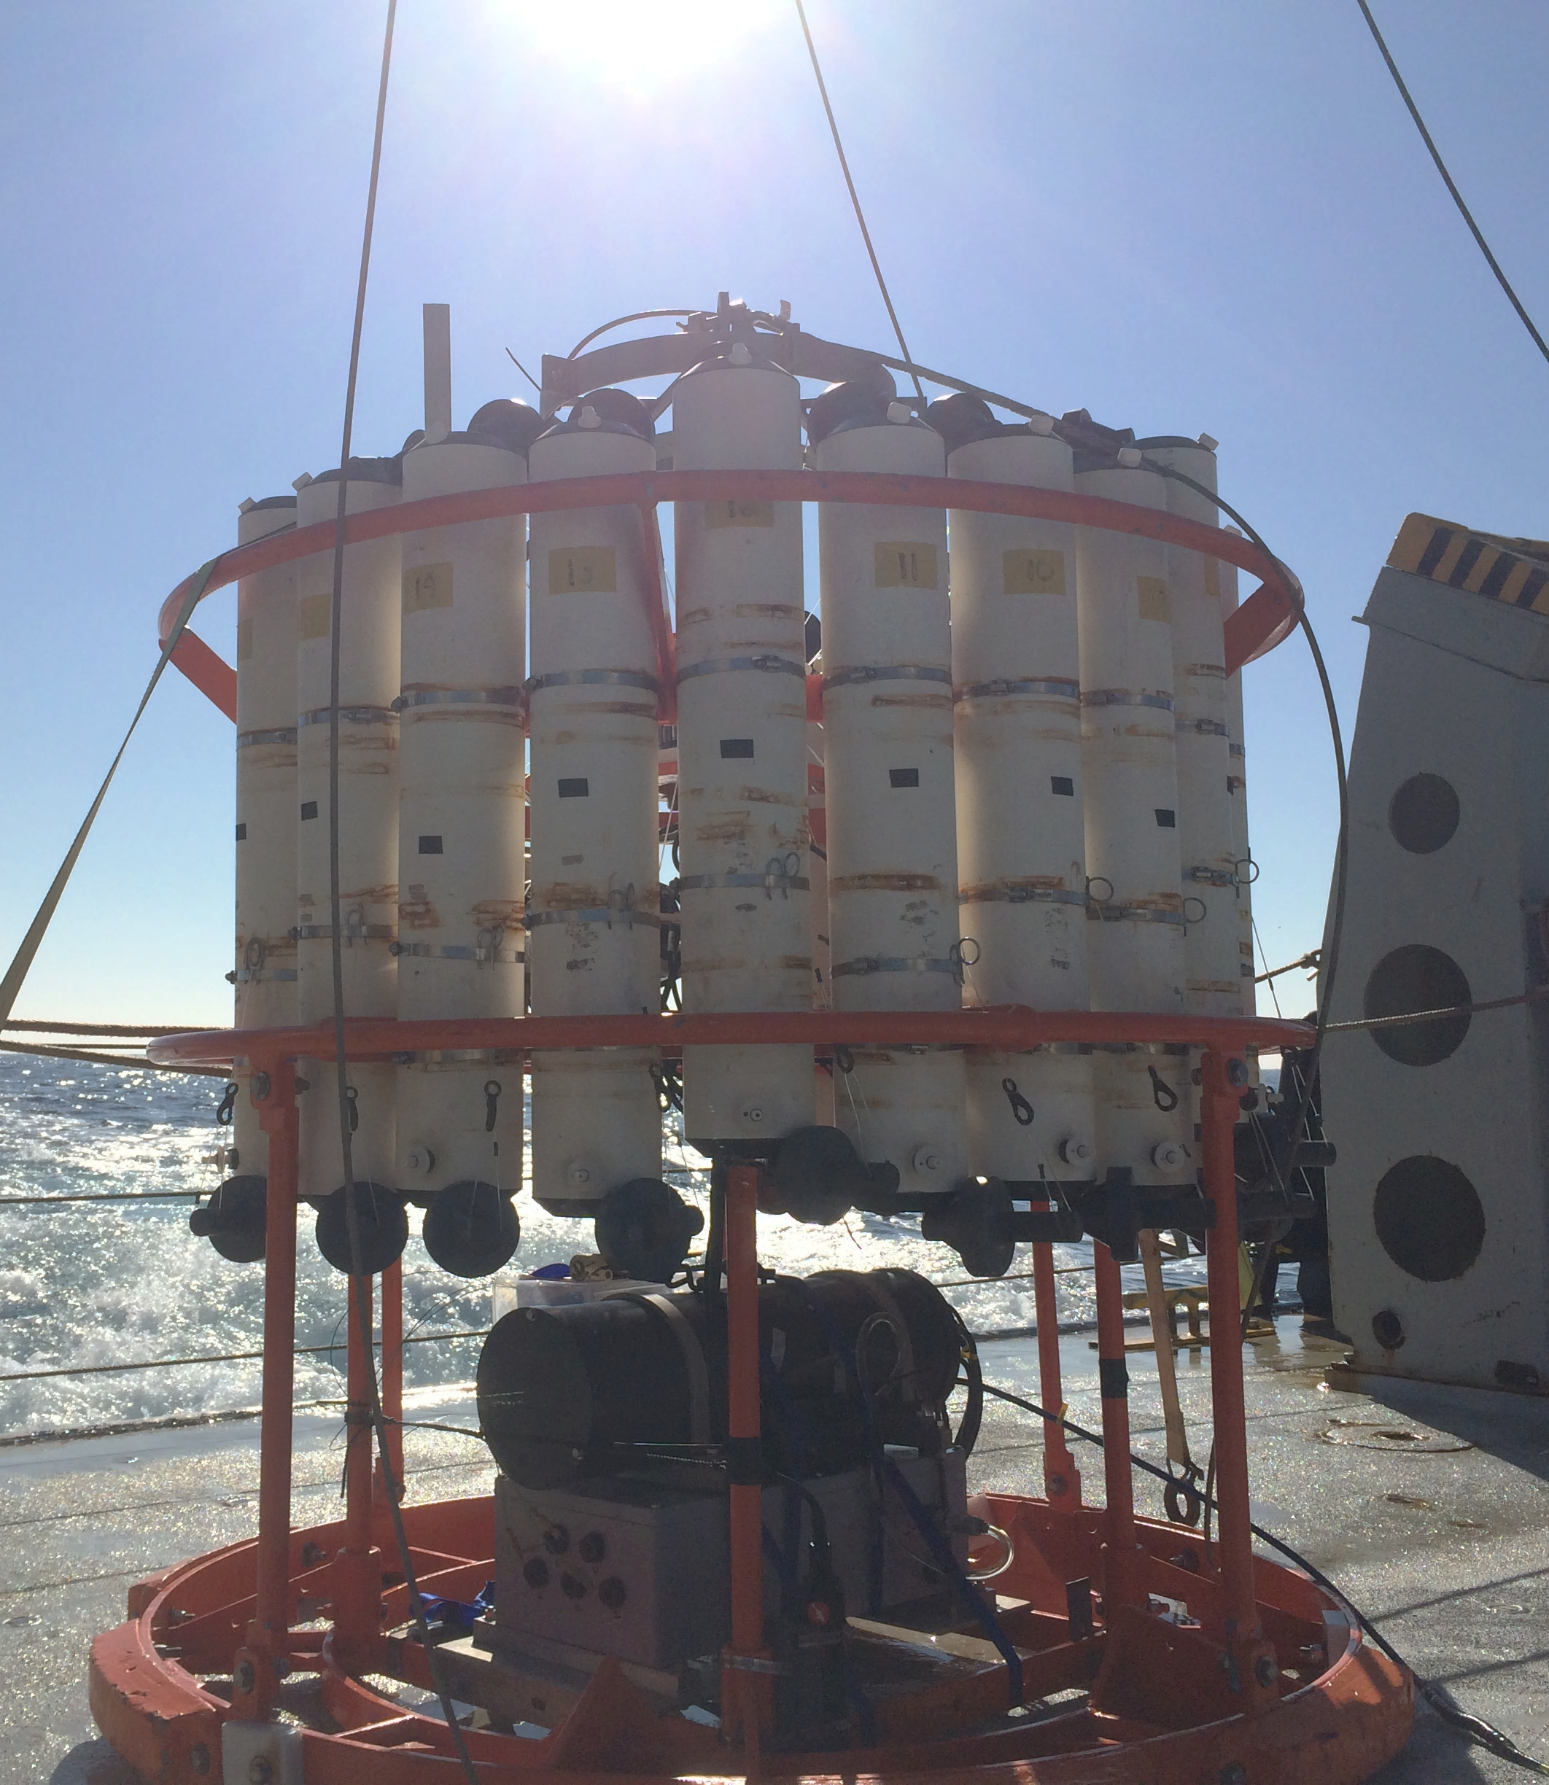
Paper Syllabus

Slide 7
Canvas

Slide 8
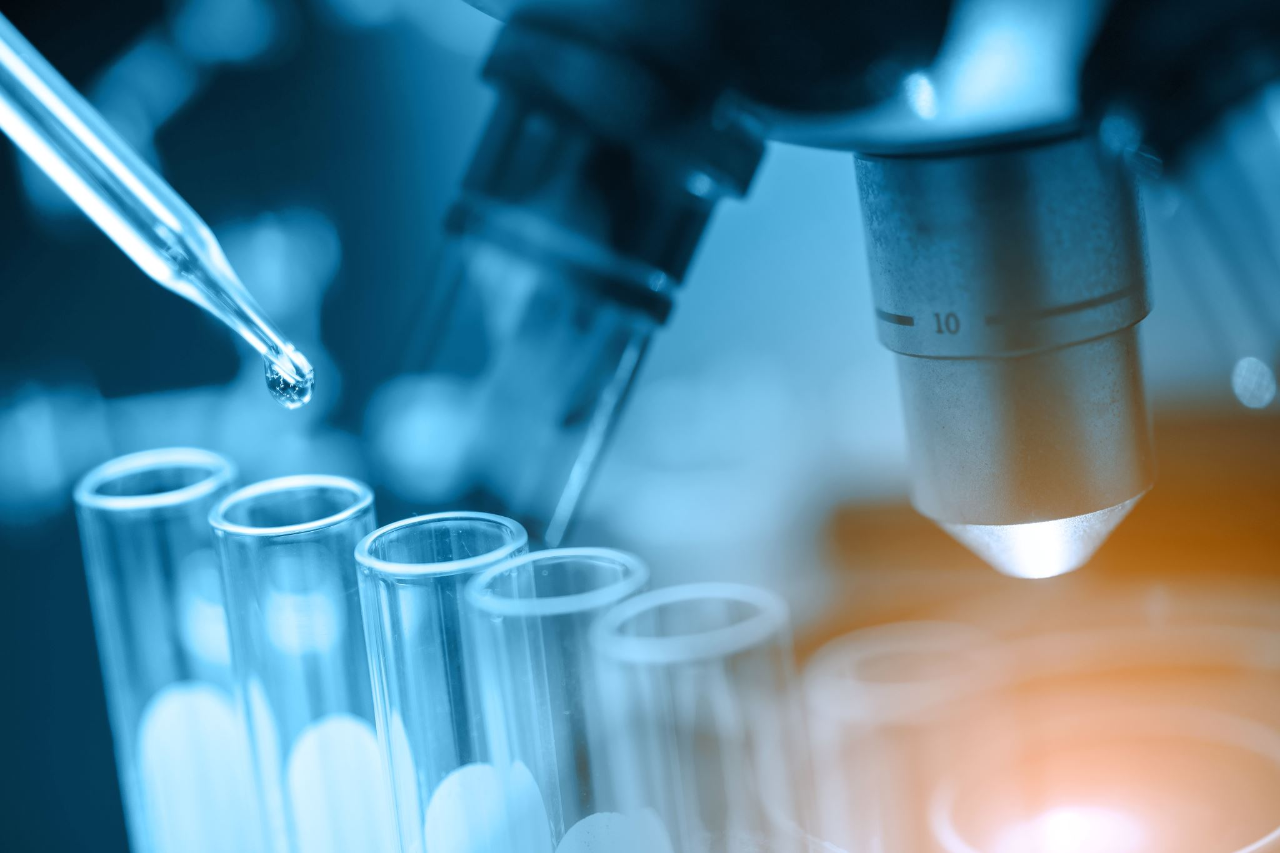
What this course is not
Follow the textbook/lab instructions/cookbook and replicate what other students have done in other semesters

Slide 9
What this course aspires to provide
An opportunity to build something new and innovative
Hands-on, applied learning
Job/grad school skill training
Challenges without known answers

Slide 10
Course motto
Progress, not perfection

Slide 11

Skills and techniques (who has done some of these?)
Soldering
Breadboarding/wiring
Arduino microcontroller coding
Python data analysis
3D printing
Using way too much glue, duct tape, zip ties
Kayaking???

Slide 12
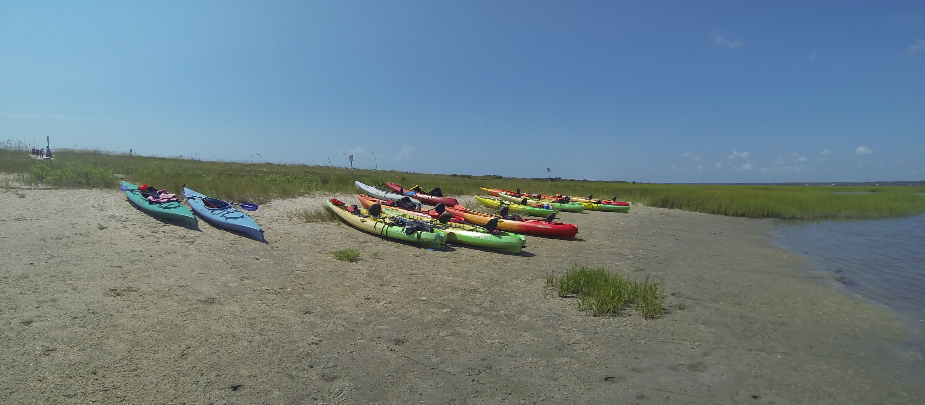
Always looking for students
DIS (directed independent study), honors thesis, graduate school eventually, some hourly paid opportunities

Slide 13
Next week:
Meet in CMS lobby at 10 am
Tour of Ocean Instrumentation and Undersea Vehicle Labs and CMS Research Pier with Dave Wells

Slide 14
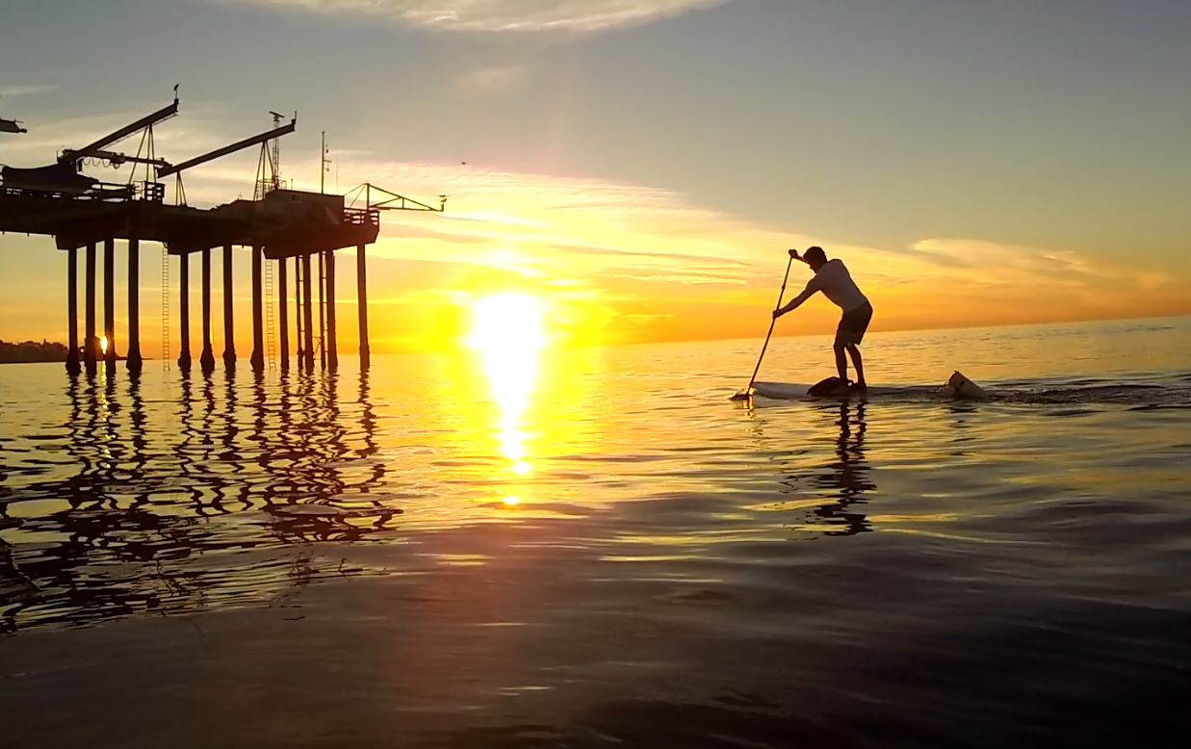
Lecture questions?
Lab activity next…

Slide 15
Intro Lab
Blink an LED & print “hello, world”

Slide 16
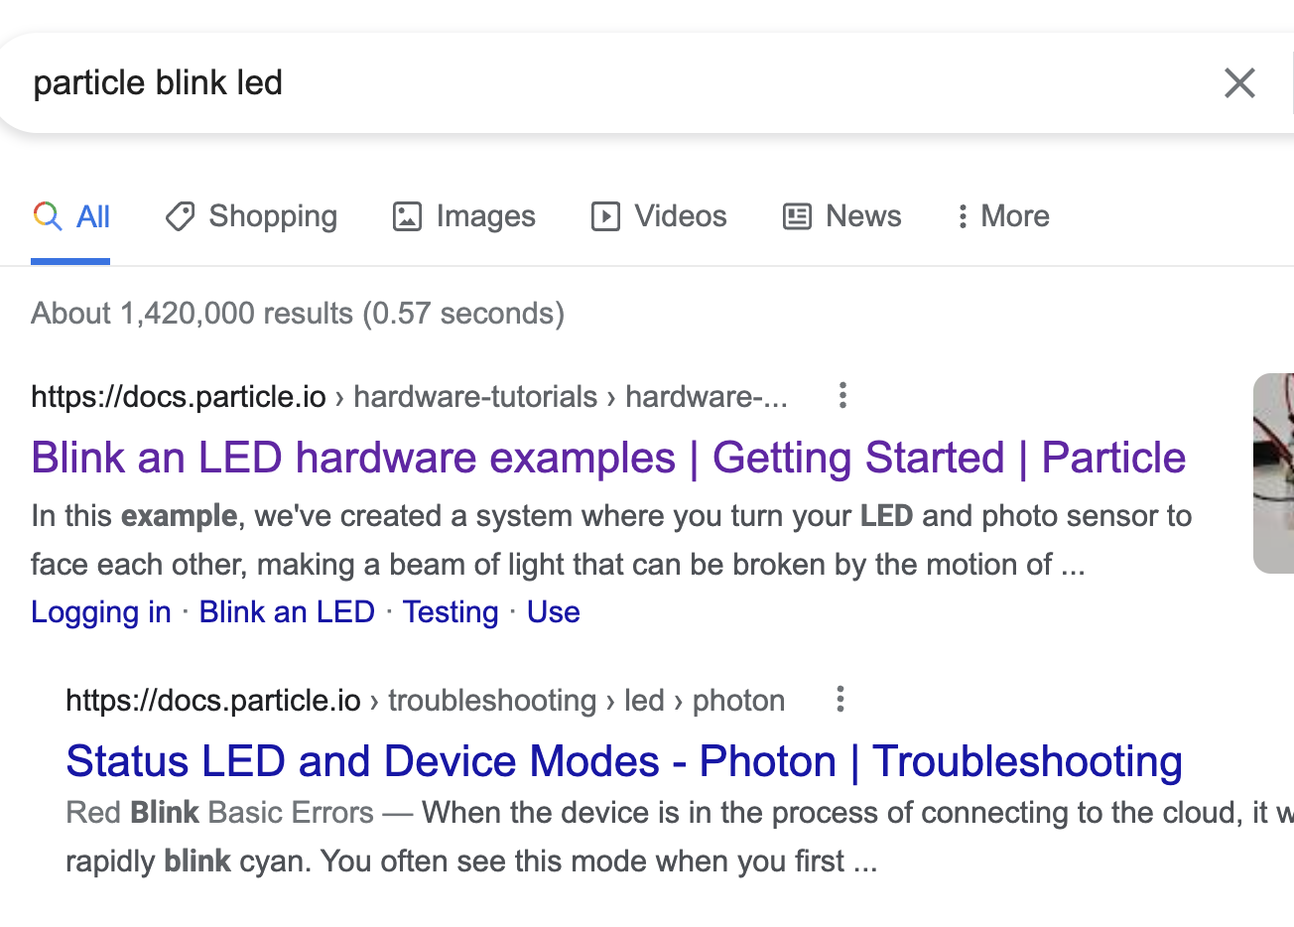
Getting Started
Goal: blink an on-board LED & print “hello, world”
Get a Particle Argon (we’ll talk more about these devices later)
Find Particle.io example instructions
DO NOT ENTER CREDIT CARD INFO FOR THESE DEVICES FOR THIS CLASS!

Slide 17
What we’re working toward
Design and build of low-cost ocean optical sensors
Measure water quality, sediment transport
Next week:
Tour of Oceanographic Instrumentation Lab (meet in lobby @ 10)
Read Leeuw & Boss paper and Eidam et al. papers (in Canvas)
Think about these things:
why did they do what they did
how did they do what they did
how do they suggest (and do you think) improvements could be made

